Slide 1
Financial Aid Presentation for New Jersey High Schools
2024-2025 Academic Year

Slide 2
The Mission
The Higher Education Student Assistance Authority is the only State agency with the sole mission of providing students and families with the financial and informational resources to pursue their education beyond high school.
Higher Education Student Assistance Authority
2
Notes:
HESAA Information Detailed:
Financial aid session
FAFSA Days
Booklets: State and Federal Aid, Financial Aid Dictionary, Student Loan Guide, and Reach Higher the College Planning Booklet.
Handouts: Eight Steps to Apply, Financial Planning Chart, and program brochures are available for free.
REAL $ 101 Financial Literacy on-site Sessions

Slide 3
Goals of Financial Aid Office
Primary goal is to assist students in paying for college and is achieved by:
Evaluating family’s ability to pay for educational costs
Distributing limited resources in an equitable manner
Providing a balance of grants/scholarships & wages from school/federal sponsored student employment.
Implementing federal and state regulations for their college/university
Higher Education Student Assistance Authority
Notes:
Gatekeepers of the financial aid funds.

Slide 4
Sources & Types of Aid
Sources of Aid
The College/University
Federal
State of New Jersey
Outside Organizations
Civic organizations (ex. local Rotary Club), parent’s employer, high school awards
Types of Financial Aid
Grants
Scholarships
Employment Opportunities
___________________
Student/Family resources such as savings
Self Help - Loans
Factors that may influence institutional aid, particularly merit-based aid
Academics
Athletic Ability*
SAT’s or ACT’s
Geographic Diversity
AP Courses
Legacy (child of alumni)
Activities
Talent
Academic Track
Gender/Ethnicity
H.S. Attended
Class Rank
Higher Education Student Assistance Authority

Slide 5
Net Price Calculator
All institutions must have a net price calculator posted on their websites.
Students will be able to estimate the individual net price per institution.
Based on full-time, first degree/certificate-seeking undergraduate students.
Higher Education Student Assistance Authority
Notes:
HESAA also has on the website the NJEI calculator that calculates TAG for estimate purposes only.

Slide 6
Types of Aid - Federal
Grants
Federal Student Aid 2023-24
Pell $7,395 (max award)
SEOG $4,000 (max award)
TEACH $3,772 (max award)
.
* 2024-25 award amounts subject to change
Higher Education Student Assistance Authority
Notes:
Speaker Notes
PELL- SEOG
Named after senator Pell of Rhode Island, Pell is covered under the Higher Education Act of 1965
Pell is need based and all those with an EFC low enough are eligible so long as he or she has not received a first bachelor’s degree yet or are enrolled in a post baccalaureate program that leads to a teacher’s certification or licensure
Currently, the maximum amount is $5,920 and for 17 - 18. The amount of the award will depend on financial need, cost of attendance, and full time or part time status
The limit on Pell is 12 semesters in duration (roughly 6 years)
SEOG can range from $100 to $4000 – funding is provided by the US Department of Education to institutions to manage. Goes to most needy first and are very limited.
The TEACH Grant As a condition for receiving a TEACH Grant, you must sign a TEACH Grant Agreement to Serve in which you agree to (among other requirements) teach
in a high-need field
at an elementary school, secondary school, or educational service agency that serves students from low-income families
for at least four complete academic years within eight years after completing (or ceasing enrollment in) the course of study for which you received the grant.
Iraq and Afghanistan Service Grants
The Iraq and Afghanistan Service Grant is provided to certain students whose parent or guardian was a member of the U.S. armed forces and died as a result of military service performed in Iraq or Afghanistan after the events of 9/11. May not be eligible for a federal PELL Grant but must meet remaining eligibility requirements.
Max award for 17-18 after 10.1.17 is $5,529.28
https://studentaid.ed.gov/sa/about/announcements/sequestration#iraq-afghanistan

Slide 7
New Jersey State Grants 2023-24 Academic Year (2024-2025 award amounts to be determined July 2024)
Award Type | Award Amounts
Full-Time TAG | $1,280 - $14,404
Part-Time TAG (community college only) | $320-$1,097
EOF (Educational Opportunity Fund) | Up to $3,050 includes college success support
NJ STARS (top 15.0% of high school class junior or senior year) | Tuition Only - community college only
NJ STARS II | Up to $2,500 per year – any NJ 4-year college
Governor’s Urban Scholarship (GUS) | Up to $1,000
NJ-GIVS (women and minorities) | Up to $2,000 building trades only
Community College Opportunity Grant (CCOG)! | After all other grant/scholarship aid- tuition and most fees – FREE for AGI $65,000 or less, $65,001 to 80,000 is 50% reduced tuition & fees, and $80,001 to $100,000 is 33% reduced tuition and fees
Garden State Guarantee (GSG) | After all other grant/scholarship aid- tuition and most fees – FREE for AGI $65,000 or less, $65,001 to 80,000 is not to exceed $7,500 tuition & fees, and $80,001 to $100,000 is not to exceed $10,000 tuition and fees
Summer TAG | Must be enrolled in summer coursework at least half-time and received at least one TAG payment in the prior academic year.
Higher Education Student Assistance Authority

Slide 8
State Grants & Scholarship Requirements
Students must have a complete Application for TAG (Tuition Aid Grant) and all other state programs. Student must be:
File a FAFSA or New Jersey Alternative Financial Aid Application
Be a U.S. citizen, eligible non-citizen or qualify as an NJ Dreamer
Be a New Jersey resident & attend a New Jersey institution
Be enrolled full-time* in an approved degree program
Demonstrate financial need
Meet all state deadlines for application and document submission
*Part-Time TAG awards are available for county college students enrolled 6-11 credits per semester. Summer TAG also available for all students enrolled in 6-11 summer course credits if received TAG during preceding academic year.
Higher Education Student Assistance Authority
Notes:
EOF (excellent program for financially and economically disadvantaged students)
EOF supports a wide array of campus-based outreach and support services to help program participants succeed and graduate
Benefits
Students enrolled in an EOF program receive financial assistance through semester grants ranging from $299 to $1,024. Family must have a documented history of financial and economic disadvantage - Some schools require that you are a first generation college student.
The amount of the grant varies depending upon financial need, cost of attendance and available funding. Awards are renewable annually based on continued eligibility.
Tuition Equity Law: DACA & Undocumented students - Complete the NJ Alternative Application if you are not a United States citizen or eligible noncitizen and meet all of the following criteria;
Attended a New Jersey high school for at least three (3) years
Graduated from a New Jersey high school or received the equivalent of a high school diploma in New Jersey
Registered for Selective Service (male students only)
Are able to file an affidavit stating that you will file an application to legalize your immigration status or will file an application as soon you are eligible to do so

Slide 9
Types of Aid: State Grants & Scholarships
Summer TAG (Tuition Aid Grant)
Received TAG in the prior Fall or Spring semester
Award range dependent upon enrollment status
Full-time, Three Quarter-time, or Half-time
EOF (Educational Opportunity Fund)
Award ranges from $200 - $3,050 annually depending on institution.
EOF award amount also varies based on decision/discretion of campus EOF office.
Must demonstrate educational and economically disadvantaged background
Complete all required EOF tasks
Higher Education Student Assistance Authority
Notes:
EOF (excellent program for financially and economically disadvantaged students)
EOF supports a wide array of campus-based outreach and support services to help program participants succeed and graduate
Benefits
Students enrolled in an EOF program receive financial assistance through semester grants ranging from $299 to $1,024. Family must have a documented history of financial and economic disadvantage - Some schools require that you are a first generation college student.
The amount of the grant varies depending upon financial need, cost of attendance and available funding. Awards are renewable annually based on continued eligibility.
Tuition Equity Law: DACA & Undocumented students - Complete the NJ Alternative Application if you are not a United States citizen or eligible noncitizen and meet all of the following criteria;
Attended a New Jersey high school for at least three (3) years
Graduated from a New Jersey high school or received the equivalent of a high school diploma in New Jersey
Registered for Selective Service (male students only)
Are able to file an affidavit stating that you will file an application to legalize your immigration status or will file an application as soon you are eligible to do so

Slide 10
Types of Aid: State Grants & Scholarships
Governor’s Urban Scholarship
Rank within the top 5% of their class at the end of junior year
Attain a 3.0 GPA at the end of the junior year
Reside in a designated community
Having financial need making the student eligible for a TAG award
Higher Education Student Assistance Authority
Notes:
EOF (excellent program for financially and economically disadvantaged students)
EOF supports a wide array of campus-based outreach and support services to help program participants succeed and graduate
Must graduate from a traditional public, public charter, county vo-tech or nonpublic school and reside in any of the following townships
GUS - $1,000 annual award – top 5% of HS graduating class
Asbury Park City
Camden City
East Orange City
Irvington Township
Jersey City
Lakewood Township
Millville City
Newark City
New Brunswick City
Paterson City
Plainfield City
Roselle Borough
Trenton City
Vineland City

Slide 11
Types of Aid: State Grants & Scholarships
NJ STARS
NJ residents who rank in the top 15.0% of their class at either the end of junior or senior year of high school
Students must attain a cumulative GPA of 3.0 or higher at the start of the third semester at the county college to remain NJ STAR eligible
NJ STARS II
Received NJSTARS funding and have a family taxable income of less than $250,000
Must earn an associates degree and graduate with a 3.25 GPA or higher
May receive up to $2,500 annually for a public or private 4-year NJ college or university
Must take at least 12 college credits per semester (may enroll part-time for at least or 6 credits with a qualified doctors note)
Higher Education Student Assistance Authority
Notes:
Governor Christie signed Public Law 2012, Chapter 8 (PL 2012, c.8) into law on May 2, 2012 amending the NJ STARS and NJ STARS II Programs to make them more sustainable.
Limits the amount of the NJ STARS scholarship to tuition only. Budgetary footnote language has limited NJ STARS awards to tuition only since fall 2010 for new program participants.
Eligibility requirements are unchanged.
Must graduate in the top 15.0% of their high school graduating class.
NJ STARS-eligible students must file a FAFSA and complete the State grant record within established State deadlines.
Students may be eligible to receive NJ STARS awards for up to five semesters. Funds are not available to cover summer payments.
NJ STARS-eligible high school graduates may receive awards based on tuition only, after deducting any other federal and/or State grants and scholarships.
Students must attain a minimum cumulative grade point average (GPA) of 3.0 or higher at the start of the third semester of county college enrollment to remain eligible for NJ STARS. Summer courses are included in determining the cumulative GPA.
Students must maintain continuous full-time enrollment unless on a medical leave that is approved by the county college prior to the completion of the semester for which the leave is being granted.
NJSTARS II
Eligibility Requirements as follows:
Earn an associate degree from their home New Jersey county college as an NJ STARS recipient. Must graduate with a cumulative GPA of 3.25 or higher.
Family income (taxable and untaxed income) must be less than $250,000 as derived by the FAFSA
Meet all other program eligibility requirements, including admission into a baccalaureate program at a New Jersey four-year public or private college or university that participates in the TAG program
Complete a FAFSA and the State grant record within established State deadlines
NJ STARS II benefits for non-renewal students were changed by Bill PL 2012, c.8
Non-renewal NJ STARS II students may receive up to $1,250 per semester, paid completely by the State, after all other sources of federal and State grants and scholarships are applied to tuition charges.
Open to all four-year TAG-participating institutions-public or private

Slide 12
Types of Aid: State Grants & Scholarships
Governor’s Industry Vocation Scholarship for Women & Minorities
NJ-GIVS
Up to $2,000 per year for the cost of enrollment at one of New Jersey’s 18 County Colleges, Technical / Vocational Schools, some Proprietary Schools
Benefits women and minorities pursuing certificate or degree programs in construction related fields
Must be NJ resident and have AGI < $60,000
Complete separate application online. Found in the student's NJFAMS account, Apply for Scholarships
Some of the programs eligible for the scholarship include
Construction Supervision
Solar Energy Technology
Architectural Engineering Technology
Higher Education Student Assistance Authority
Notes:
Complete an NJ – GIVS application at njgrants.org
Eligible certificate or degree program

Slide 13
CCOG County Vo-tech Pilot
Approved Vocational Technical Programs at County Vocational Technical Schools, County Colleges, and certain Tech schools
Students must be enrolled in at least one eligible county vocational-technical course in FY 2024
Students are eligible for funding for one course during FY 2024
Students who have already earned a bachelors or associate degree are not eligible
Students will receive tuition coverage on a last dollar basis, after first accounting for any grants or employer support the student may receive.
Students must have an Adjusted Gross Income between $0-$100,000
Students with AGIs between $0 and $65,000 will eligible for a full CCOG-CVT award
Students with AGIs between $65,001 and $80,000 will be eligible for a 50% CCOG-CVT award
Students with AGIs between $80,001 and $100,000 be eligible for a one-third CCOG-CVT award
Eligible programs:
Automotive Technology
Medical Assisting
Dental Assisting
Phlebotomy
Cosmetology
LPN
Veterinary Assistant
Culinary Arts
Certified Nurses Aid
Audio Engineering
Computer Science
Basic Electrical
Health & Fitness Technology
A+COMPTIA Computer Technician
Higher Education Student Assistance Authority

Slide 15
Types of Aid: State Grants & Scholarships
Community College Opportunity Grant (CCOG)
Pays for all or part of the cost of Tuition and Approved fees at a NJ county college
Must take a minimum of six credits per semester
Must make satisfactory academic progress
Tier I | AGI $0 - $65,000 for maximum award: Tuition Free
Tier II | AGI $65,001 – 80,000 for 50% of the maximum award at that county college
Tier III | AGI $80,001 - $100,000 for 33% of the maximum award at that county college
Higher Education Student Assistance Authority
Notes:
Complete an NJ – GIVS application at njgrants.org
Eligible certificate or degree program

Slide 16
Types of Aid: State Grants & Scholarships
Garden State Guarantee
Pays for all or part of the cost of Tuition and Approved fees at a NJ state college
New Jersey State Colleges and Universities
Must make Satisfactory Academic Progress
Available for students in their third and fourth year of enrollment at a public 4-year institution
Tier I | AGI $0 - $65,000 for maximum award: Tuition Free
Tier II | AGI $65.001 – 80,000 pay net price of no more than $7,500, tuition and fees
Tier III | AGI $80,001 - $100,000 pay net price of no more than $10,000 tuition and fees
Higher Education Student Assistance Authority
Notes:
Complete an NJ – GIVS application at njgrants.org
Eligible certificate or degree program

Slide 17
3 + 1 Degree Completion Programs
Student enrolls in a bona fide 3 + 1 major/degree program
Student completes the first two years at the community college and earns an Associate Degree
Pays community college tuition and fees for the associate degree and the third year of their bachelor’s degree program
Attends and pays the four-year institution‘s tuition and fees in the final year of the bachelor degree
Meet all other eligibility criteria for TAG, NJSTARS, CCOG
Higher Education Student Assistance Authority

Slide 18
Loans & Financing Shortfall Solutions
Monthly Payment Plans – offered by the college
Federal Direct Loan Program (1st year dependent student)
Subsidized Loan $3,500 need based
Unsubsidized Loan $2,000 additional
2023 - 2024 - Federal Undergraduate Direct Loan interest rates are 5.50%, plus a 1.057% origination fee
2024 – 2025 Rates and fees are subject to change
Higher Education Student Assistance Authority
Notes:
Graduate Stafford loans are now 6%

Slide 19
Other Loan Options to Cover the Gap Borrow up to cost of attendance
2024 – 2025 Interest Rates will be determined in mid 2024
Higher Education Student Assistance Authority
Notes:
We also offer consolidation programs & a ReFi program that
Consolidation extends the repayment term to 25 – 30 depending on loan balance and takes the weighted average of the loans minus a tiny percentage
The ReFi program is a 10 year repayment term and is based on income, credit score and debt to income ratio (depending on credit score the APR will range from 4.90% to 6.90%
HESAA also now has a Repayment Assistance Program (RAP), which is designed to provide payment relief when all parties of the loan are facing financial hardship
During the RAP period, a payment on eligible NJCLASS loan shall be reduced to 10% fo the total of the household income of all of the parties to the loan that exceeds 150& of the federal poverty guidelines for their family size, with a minimum monthly payment of $5 per eligible loan
Interest that accrues during RAP will be paid by HESAA
RAP is available for NJCLASS loans with applications that were received on or after June 1, 2017 or are to be used for an academic term that begins on or after August 1, 2017
HESAA now also discharges the loan obligation for all parties to a NJCLASS loan in the event of death or total and permanent disability of the student beneficiary

Slide 20
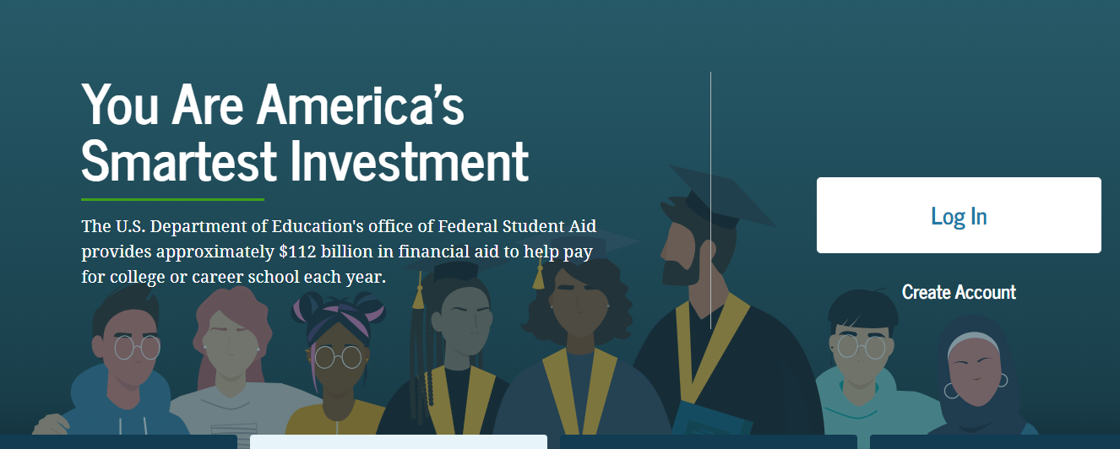
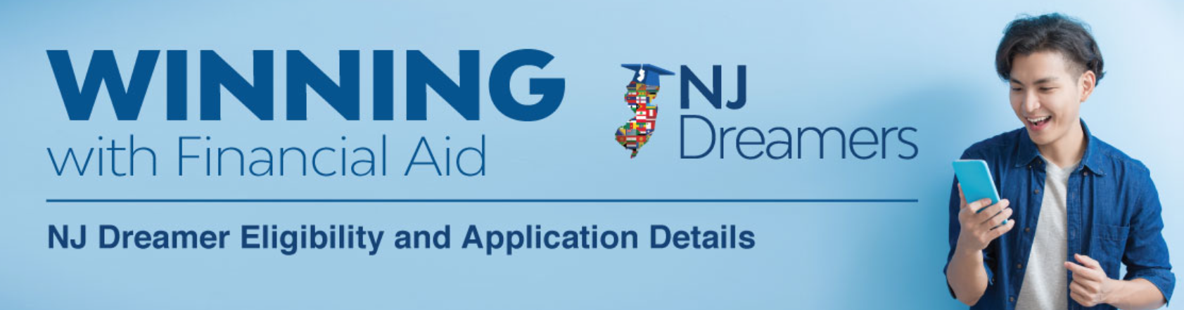
Applications to Access Aid
studentaid.gov
Available December 2023
student.collegeboard.org/profile
Available October 1, 2023
HESAA.org
Available December 2023
Higher Education Student Assistance Authority
Notes:
Jules / Sharon – please add screen shot for alt app

Slide 21
Application: CSS Profile
Approximately 400 Colleges and Organizations use the CSS profile to determine how they will award institutional (school funded) aid
Available 10/1 each year and collects more comprehensive income, asset, and household information than the FAFSA
Uses prior - prior year income (2022 for 2024-2025)
Mostly used by independent (private) colleges & universities
Register – Complete Application – Make payment – Submit
No payment for income under $100,000
All others, $25 for first application and $16 for each additional
Higher Education Student Assistance Authority
Notes:
Check out http://student.collegeboard.org/profile for a list of institutions that require CSS profile
CSS profile uses institutional methodology formula whereas FAFSA uses federal methodology
The CSS profile is a fee based application. The cost for filing the CSS PROFILE is $25 for the first college, and there is an $16 processing fee for each additional college. This is not the FAFSA. The FAFSA is free.
Can take 45 minutes to 2 hours to complete
Can leave some answers blank but an error will prompt if answer is required but most numeric questions at least require a zero

Slide 22
CSS Profile
Website to apply for profile
https://cssprofile.collegeboard.org/
Website to apply for Noncustodial Profile:
https://www.proprofs.com/training/course/?title=202223-completing the-css-profile-for-noncustodial-parent_610a90e612320
Customer Support - 844-202-0524 | Live Chat Available
Higher Education Student Assistance Authority
20
Notes:
Links are correct

Slide 23
Free Application for Federal Student Aid (FAFSA)
2024-2025 “A Better” FAFSA is available December 2023
Collects family’s personal and financial information used to calculate the student’s Student Aid Index (SAI). The SAI determines eligibility for federal student aid
File the FAFSA electronically via FAFSA on the Web at www.studentaid.gov
FAFSA Uses prior-prior year income information (2022 for award year 2024-25)
All contributors on the application (student & parent(s)) must provide consent to the IRS to obtain Federal Tax Information (FTI) to populate income & tax information with actual prior-prior year tax information
All prior-prior year tax information (2022) is already filed, allowing immediate retrieval.
Higher Education Student Assistance Authority
Notes:
You should use the IRS DRT at the time of filing the initial FAFSA. Using this tool will automatically verify your information for federal

Slide 24
2024-2025 Federal Student Aid ID
Used to provide consent to obtain Federal Tax Information and digitally sign the FAFSA
Student and all information contributors must create a Federal Student Aid ID (FSA ID) at www.studentaid.gov by clicking on “create account”
Student Identifies who the information contributor(s) are and invites them to contribute to the FAFSA. Each contributor must have their own separate FSA ID and password.
Information contributors Include: Biological Parent, Stepparent, and Adoptive Parent
One parent if two parents filed taxes jointly
Parent who provided more financial support in the last 12 months, if parents are divorced/separated
If married or unmarried/living together but did not file taxes jointly, then both contributors will need an FSA ID
All contributors must be verified by individual email when creating the FSA ID
Higher Education Student Assistance Authority
Notes:
The FSA id is a higher security login which will connect the student and parent to the FAFSA. The FSA id will also connect the student to the federal student aid website, and the National student loan data base.

Slide 25
2024-2025 Federal Student Aid ID for Undocumented Contributors Available December 2023
Information Contributor(s) without a Social Security Number must use 000-00-0000 to create their FSA ID and will have to verify identity through a knowledge based verification process.
Information Contributors who cannot verify identity will be prompted to contact Federal Student Aid (FSA) to submit documentation and if still cannot verify identify must complete a paper FAFSA
All contributors must be verified by individual email when creating the FSA ID
Higher Education Student Assistance Authority
Notes:
The FSA id is a higher security login which will connect the student and parent to the FAFSA. The FSA id will also connect the student to the federal student aid website, and the National student loan data base.

Slide 26
Federal Tax Information (FTI)
The IRS will request consent to retrieve your Federal Tax Information (FTI) into the FAFSA
The FTI will be available beginning December 2023 to support the Better FAFSA
If parents are married or unmarried/living together, but did not file taxes jointly, then both will need to login to provide consent to retrieve federal tax information
Higher Education Student Assistance Authority

Slide 27
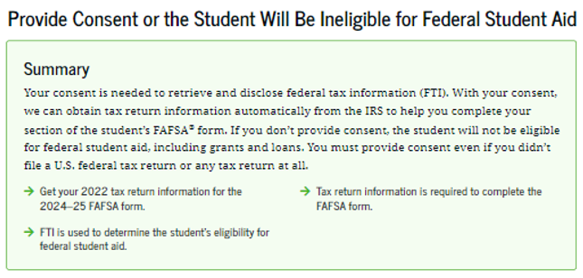
Federal Tax Information Consent
Information Contributors will be instructed to provide Federal Tax Information from their 2022 tax return to be used to determine
the student's eligibility for federal student aid for award year 2024-25
2022
2022
Higher Education Student Assistance Authority
Notes:
This

Slide 28
Key Eligibility Requirements for FAFSA
The student must have a valid Social Security Number
Must be enrolled or accepted for enrollment in an eligible program of study
Must be pursuing a degree, certificate, or other recognized credential
Must be a U.S. citizen or eligible noncitizen
New Jersey students who are undocumented and meet the NJ NJDREAMER qualifications should complete the NJ Alternative application for state funded financial aid
Higher Education Student Assistance Authority
Notes:
If you are an eligible noncitizen, write in your eight- or nine-digit Alien Registration Number. Generally, you are an eligible noncitizen if you are (1) a permanent U.S. resident with a Permanent Resident Card (I-551); (2) a conditional permanent resident with a Conditional Green Card (I-551C); (3) the holder of an Arrival-Departure Record (I-94) from the Department of Homeland Security showing any one of the following designations: “Refugee,” “Asylum Granted,” “Parolee” (I-94 confirms that you were paroled for a minimum of one year and status has not expired), T-Visa holder (T-1, T-2, T-3, etc.) or “Cuban-Haitian Entrant;” or (4) the holder of a valid certification or eligibility letter from the Department of Health and Human Services showing a designation of “Victim of human trafficking.”
If you are in the U.S. on an F1 or F2 student visa, a J1 or J2 exchange visitor visa, or a G series visa (pertaining to international organizations), select “No, I am not a citizen or eligible noncitizen.” You will not be eligible for federal student aid. If you have a Social Security Number but are not a citizen or an eligible noncitizen, you should still complete the FAFSA because you may be eligible for state or college aid.
The Selective Service System and the registration requirement for your men, preserves America’s ability to provide manpower in an emergency to the US armed forces Almost all men ages 18 to 25 must register. For more information please visit 222.sss.gov

Slide 29
Key Components of the FAFSA
Student Contributor Section
Full Name and address
Social Security Number or ITIN Number
Date of Birth
Mobile phone number (optional)
Email address
College/Career plans – 20 Colleges
Student Consent and Assets
FTI (Federal Tax Information)
Student Status: Personal Circumstances
Dependent or Independent Determination
Student Special Circumstances
Student Unusual Circumstances
Parent Contributor Section
Social Security Number
Last Name
Date of Birth
Email address
Family size – FTI
Income and Assets
Federal Means-tested benefits
Medicaid, SSI, SNAP,
Free or Reduced Lunch
TANF, WIC, WITC QHP
Business and Farm will be considered as assets in the calculation of the SAI
Child Support received is an asset
Higher Education Student Assistance Authority
Notes:
WHO IS THE PARENT
If your parent was never married and does not live with your other legal parent, or if your parent is widowed or not remarried, answer the questions about that parent.
• If your legal parents (biological and/or adoptive) are not married to each other and live together, select “Unmarried and both parents living together” and provide information about both of them regardless of their gender. Do not include any person who is not married to your parent and who is not a legal or biological parent. Contact 1-800-433-3243 for assistance in completing questions 80-94.
• If your parents are married, select “Married or remarried.” Consistent with the Supreme Court decision holding Section 3 of the Defense of Marriage Act (DOMA) unconstitutional, same-sex couples must report their marital status as married if they were legally married in a state or other jurisdiction (foreign country) that permits same-sex marriage, without regard to where the couple resides. If your legal parents are divorced but living together, select “Unmarried and both parents living together.” If your legal parents are separated but living together, select “Married or remarried,” not “Divorced or separated.”
• If your parents are divorced or separated, answer the questions about the parent you lived with more during the past 12 months. (If you did not live with one parent more than the other, give answers about the parent who provided more financial support during the past 12 months or during the most recent year that you actually received support from a parent.) If this parent is remarried as of today, answer the questions about that parent and your stepparent.
• If your widowed parent is remarried as of today, answer the questions about that parent and your stepparent.

Slide 30
FAFSA Submission Summary
2024 - 2025
New Jersey State based
This link redirects filers to view instructions regarding the NJFAMS Student Portal. Applicants are instructed to log into “NJFAMS.HESAA.org” to create a user ID and password. In 3-5 business days, students can their check awards and eligibility status and complete any outstanding items on their “To Do” list (There is no separate State Application, only a To-Do List in the state’s NJFAMS system).
Please note, all notifications will be sent to the student email address listed on the FAFSA.
Higher Education Student Assistance Authority
Notes:
Should be removed but NJ is still on the list for adtl questions.

Slide 31
Federal & State Verification
SCHOOL is responsible for verifying information for federal aid except for special circumstances
HESAA is responsible for verifying information for State aid
Schools may send request for information by mail or e-mail
Always check your school account and NJFAMS account for required tasks
Be sure to meet verification deadlines
Higher Education Student Assistance Authority

Slide 32
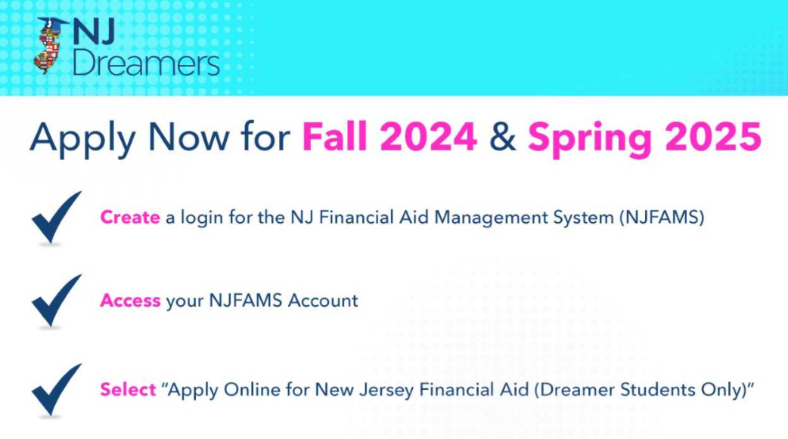
New Jersey Dreamers
Certain state aid eligible student with undocumented immigration status who attended at least 3-years and graduated from a NJ high school and met other requirements
Application is part of NJFAMS, at https://njfams.hesaa.org
Register for your account by creating a User ID and Password
Login to complete the application by established deadlines
Must meet all other need and/or merit-based eligibility criteria for state student aid
Higher Education Student Assistance Authority
Notes:
Jules / Sharon – add pic of NJFAMS login slide from NJGRANTS

Slide 33
NJFAMS
All students must go to “NJGRANTS.org”
Establish an NJFAMS Account by creating a User ID and Password
Track the status of your State-funded student aid and respond to required tasks on the To-Do List
Higher Education Student Assistance Authority
Notes:
Jules / Sharon – add pic of NJFAMS login slide from NJGRANTS

Slide 34
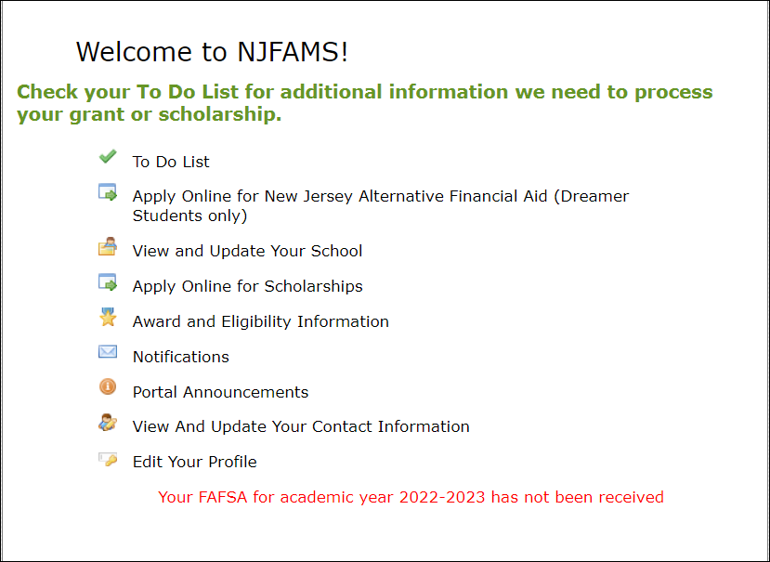
NJFAMS
Your FAFSA for academic year 2024-2025 has been received
Your FAFSA for academic year 2023-2024 has not been received
Higher Education Student Assistance Authority
Notes:
Jules / Sharon – add pic of NJFAMS login slide from NJGRANTS

Slide 35
Cost of Attendance
Tuition and fees
Food & Housing
Books and supplies, equipment, transportation, and miscellaneous personal expenses
Loan fees
Study abroad costs
Dependent care expenses
Expenses related to a disability
Expenses for cooperative education program
Higher Education Student Assistance Authority
Notes:
Unexpected costs
Remediation Classes: extra 1 – 2 semesters
Change in major: 1 – 2 years in addition
Transferring: possible extra semester
Unpaid internships: loss of Summer wages
Study Abroad, Spring break, trips home and pledging costs
Moving expenses and Summer storage

Slide 36
What Is The Student Aid Index (SAI)?
SAI is determined by a federal formula that calculates federal Pell grant eligibility and is used to determine further financial need using the information you supplied on the FAFSA
SAI & Financial Need are guidelines used by schools to determine student aid offers
SAI calculates eligibility for federal student aid, based on your family’s ability to pay college costs
Higher Education Student Assistance Authority

Slide 37
Federal Pell Grants - Sample SAI for Smith vs Jones Family
The Smith family lives in New Jersey
Married parents filing jointly
Family size of 4
2022 adjusted gross income = $94,002
Assets = $0
Student income / assets = $50 / $213
SAI = 8,667
$0 federal Pell grant eligibility
The Jones family lives in New Jersey
Married parents filing jointly
Family size of 6
2022 adjusted gross income = $94,002
Assets = $0
Student income / assets = $50 / $213
SAI = 3,764
$3,631 federal Pell grant eligibility
SAI Calculator: https://www.collegemoneymethod.com/2024-25-student-aid-index-sai-calculator/
Higher Education Student Assistance Authority
36

Slide 38
Financial Need for Smith Family
College | Community College | State College or University | Private College or University
COA | $8,000 | $30,000 | $60,000
SAI Other Financial Aid | 8,667 1,000 | 8,667 1,000 | 8,667 1,000
Unmet Financial Need | $0 | $20,333 | $50,333
Higher Education Student Assistance Authority
37
Notes:
All examples include approximate tuition, fees (left out new student fee), room and board for academic year.

Slide 39
The Cycle of Financial Aid
December - March | Complete FAFSA application (“December” for 2024-25 Only), college search, college application process, and CSS Profile
February - May | Schools send financial aid offers
June - July | Schools send Fall semester bills
August | Bills are due
Higher Education Student Assistance Authority
Notes:
CSS Profile is essential for some colleges institutional aid.

Slide 40
Where Do I Go From Here?
Obtain and review admission, financial aid materials and deadlines from each school to which you are applying
Meet all application deadlines
CSS Profile if applicable
Complete the FAFSA and any other application materials required by the school or your state agency
NJ State deadlines for high school Class of 2024:
September 15, 2024 for Fall ‘24 and Spring ‘25 semesters and February 15, 2025 for Spring ‘25 ONLY awards
April 15, 2025 to renew your financial aid for Academic Year 2025-26
Note: After 1st year, students must renew ANNUALLY by April 15th e.g., April 15, 2025 in first year for sophomore year, if the student received a State TAG award in the current year)
Higher Education Student Assistance Authority
Notes:
Deadlines for completing state grant records (tasks, verification, corrections etc…) are on our website as well as deadlines for college code changes, updates, additions and deadlines

Slide 41
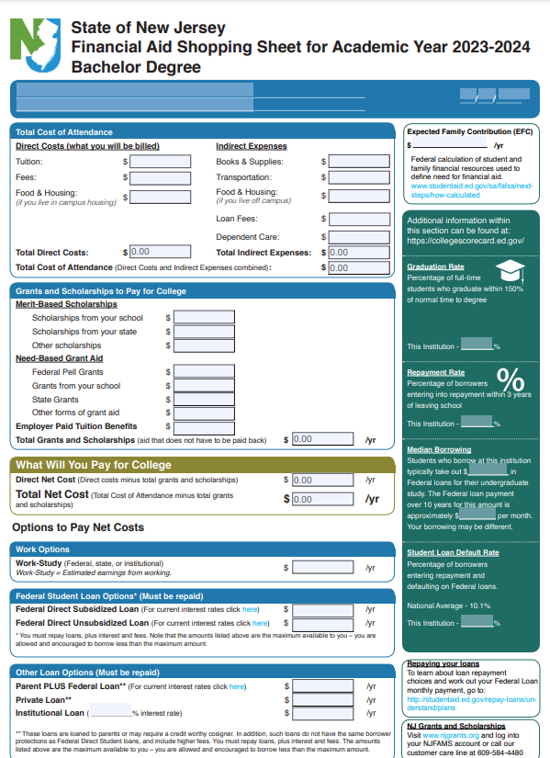
The College Financing Plan New Jersey Shopping Sheet
Help families with net cost transparency
Separates the Cost of Attendance listing the direct and indirect costs
Grants & Scholarships (no repayment required, “free money”)
Student Net Costs in center box
College coordinated work study employment
Federal Student Loans
If necessary, alternate loans
Aid Offer must replicate the Shopping Sheet
Higher Education Student Assistance Authority
Notes:
Deadlines for completing state grant records (tasks, verification, corrections etc…) are on our website as well as deadlines for college code changes, updates, additions and deadlines

Slide 42
Other Resources
Outside Scholarships
Campus-Administered Payment Plans
Campus Employment (including school-sponsored “work-study” jobs)
Specialized Campus Opportunities
Residential Advisors
Student Ambassadors
Student Tour Guides
Internships/Co-op’s
Higher Education Student Assistance Authority

Slide 43
Private Scholarship Search
Institution/college web sites
Local library resources
Local businesses, civic organizations and churches
Check with your High School guidance office
Parent’s employer(s)
www.hesaa.org
www.fastweb.com
www.collegeboard.org
www.mappingyourfuture.org
Higher Education Student Assistance Authority

Slide 44
NJBEST 529 College Savings Plan
HESAA awards a one-time scholarship ranging from $1,000 - $3,000 to NJBEST beneficiaries who enroll in a New Jersey institution after making contributions to an account for at least 4 years
NJBEST offers a matching grant up to $750 for new accounts
State tax deduction for up to $10,000 in annual contributions to an account To Learn More: https://www.hesaa.org/pages/NJBESTHome.aspx
Higher Education Student Assistance Authority
Notes:
Resource
www.njbest.com
Speaker Notes
A 529 is a tax advantaged investment plan created for American families to encourage saving for the future higher education expenses of a designated beneficiary
Scholarship is awarded within the first year
Investments grow federal income tax free and withdrawals for qualified higher education expenses are free from federal income taxes
Qualified withdrawals made by New Jersey residents are not subject to New Jersey State Income tax
A 529 can affect the student’s federal financial aid award, however, a maximum of 5.64% of parental assets can have an impact on determining financial aid eligibility where as it is 20% (up to) for students
If a dependent student is the account owner (after July 1, 2009), the available balance is treated as a parental asset
Anything above $25,000 is considered in determining eligibility for State scholarship or grant

Slide 45
Apply for State Aid Workshops & Webinars
Live Webinars
The 2024-2025 Free Application for Federal Student Aid (FAFSA®) opens December 2023.
Most colleges and universities provide FAFSA® Completion Workshops to assist families with completing the FAFSA® application. For FAFSA® Virtual Workshops dates please check your local high school or college. You are also invited to join one of HESAA’s virtual events.
Pre-recorded Webinars
Higher Education Student Assistance Authority

Slide 46
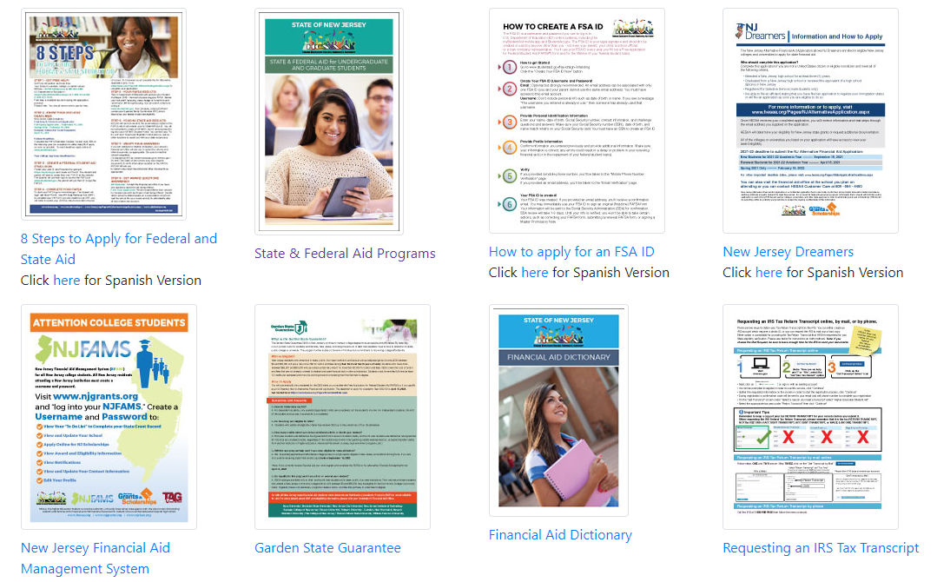
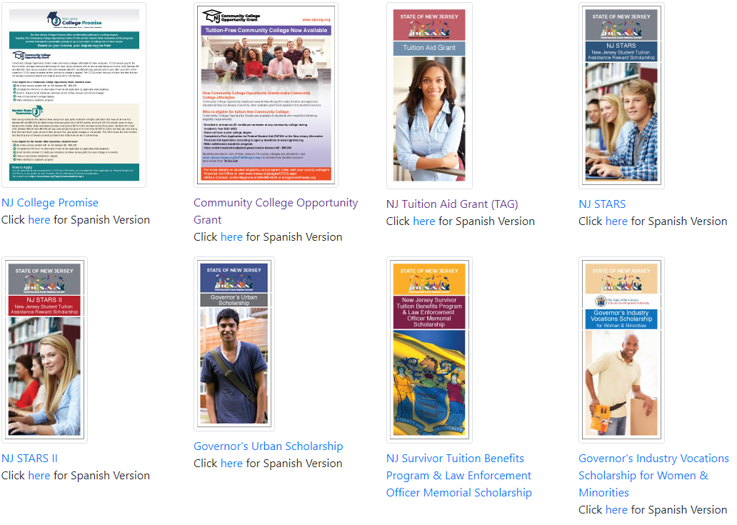
Publications
Higher Education Student Assistance Authority

Slide 47
HESAA Services
Customer Care Center
CustomerCare@hesaa.org
609-584-4480
Monday – Thursday 8:30 – 8 and Friday 8:30 – 5:00
Online Resources
www.hesaa.org
www.njgrants.org
www.njclass.org
https://njfams.hesaa.org
www.hesaa.org/pages/financialaidhub
Higher Education Student Assistance Authority

Slide 48
QUESTIONS?
Thank you
Higher Education Student Assistance Authority

